Slide 1

Winter Institute in Computational Social Science
Day 4: Social Networks
Thursday January 7th, 2020

Slide 2
Using Snowball Sampling to Study Promotion on Twitter
Yotam Shmargad
Assistant Professor
School of Govt. & Public Policy
University of Arizona

Slide 3

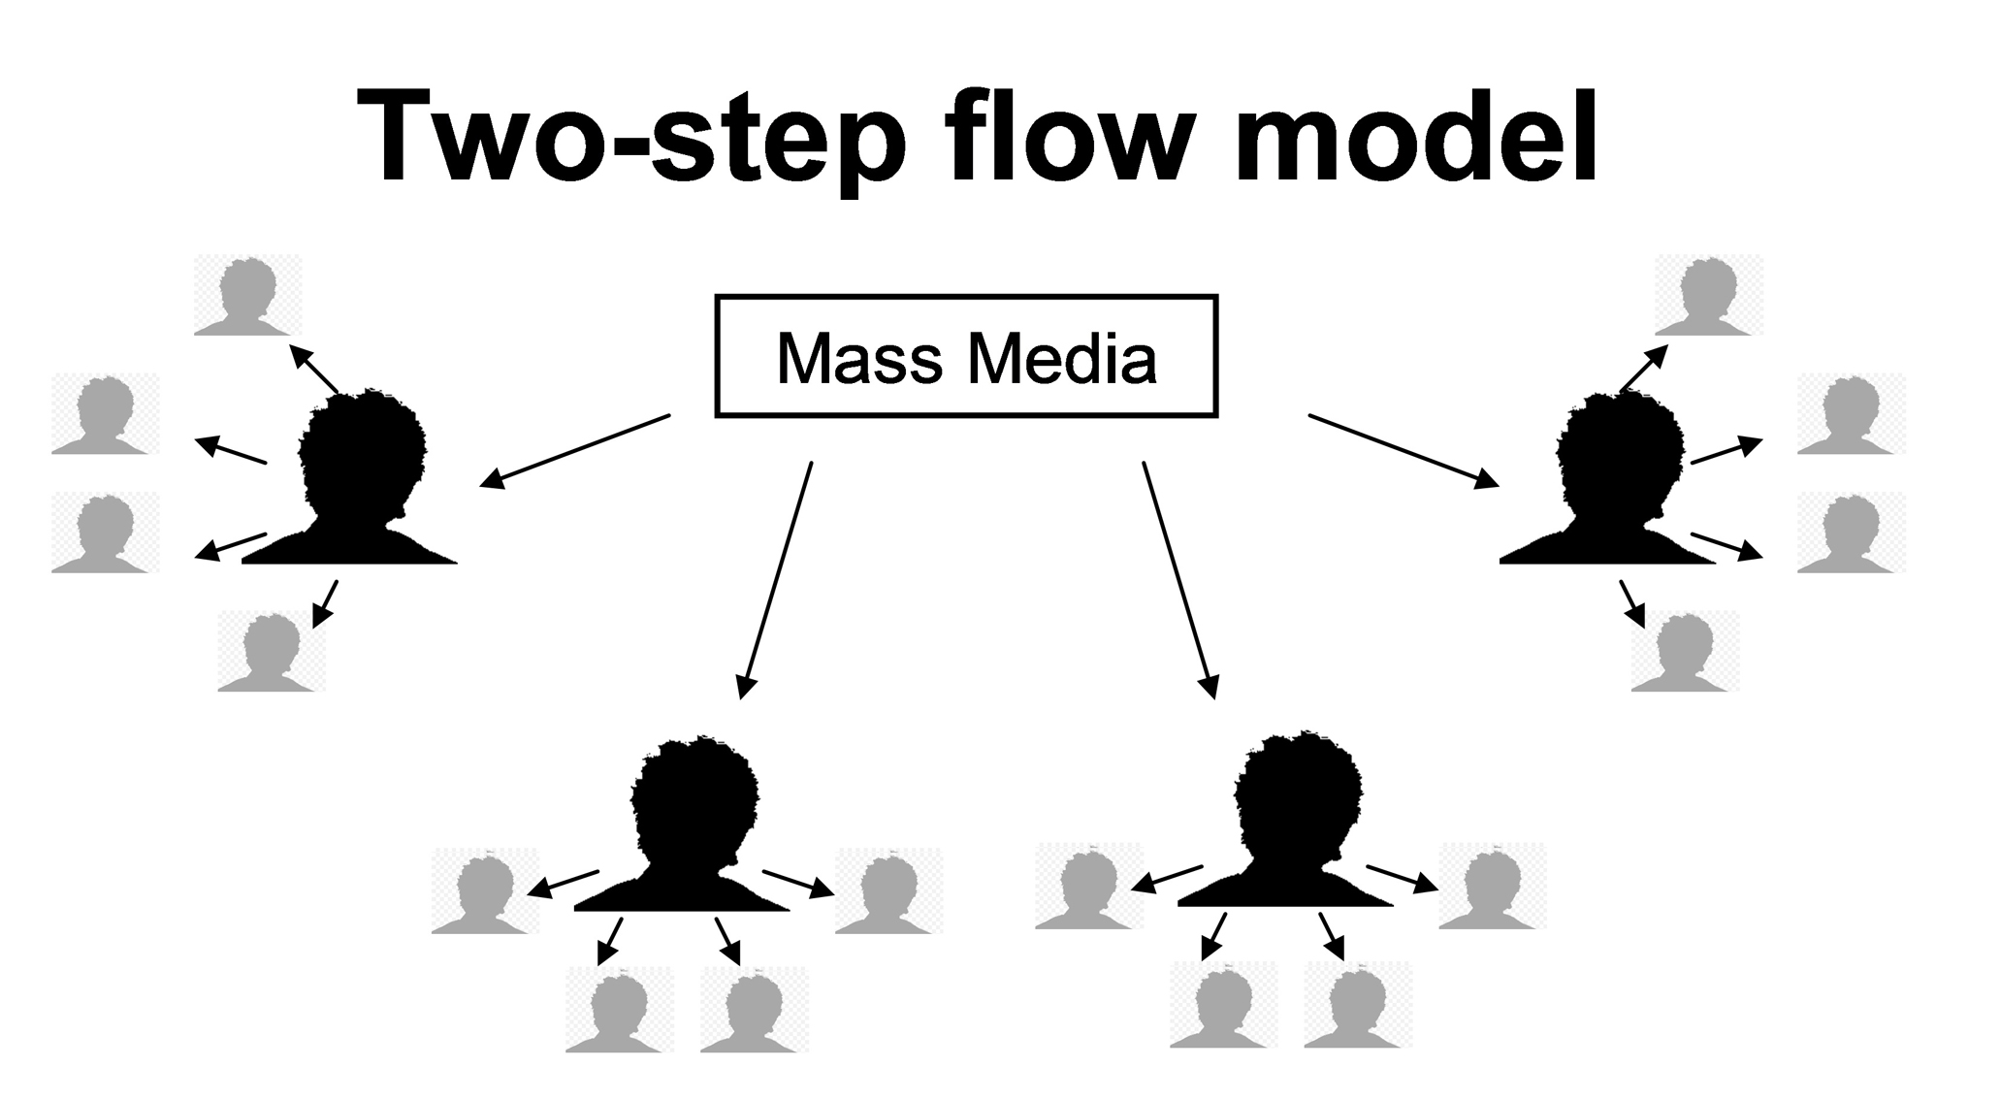
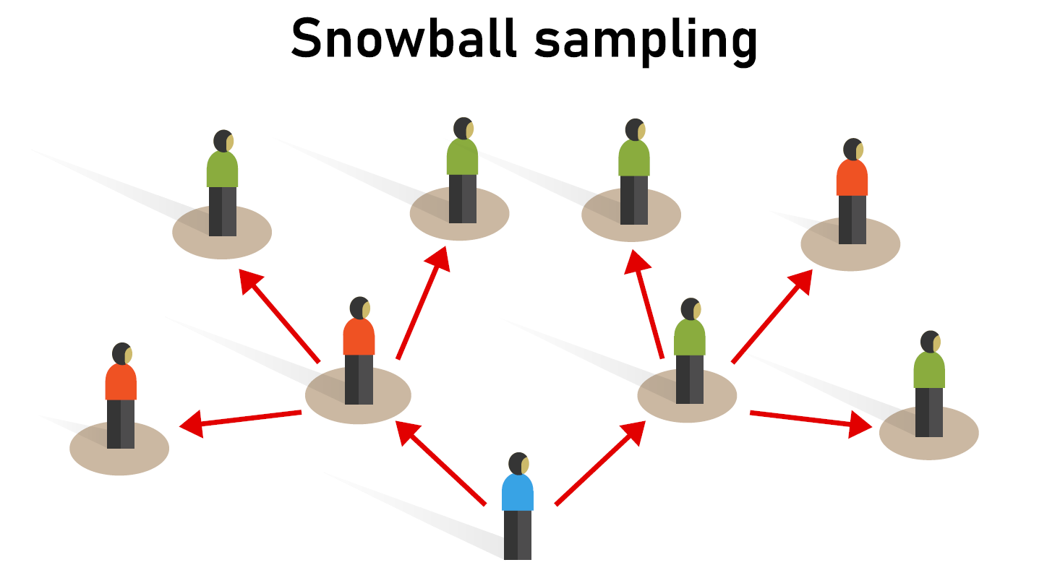
Social media platforms have altered how people get their information
Instead of searching, people discover information that others share
Information often reaches people via an ever-changing set of influencers
These influencers are often hidden – we only personally see a small sliver
3

Slide 4
The two-step flow model and snowball sampling have a shared history, but went down separate paths
Handcock and Gile (2016) offer a historical account of the connection between two-step flow and snowball sampling
Lazarsfeld et al. (1944) argue that people often learn about politics from so-called opinion leaders (or “influentials”), not mass media
To study influentials, Merton (1949) asked respondents to name people who influenced them and conducted follow-up interviews
The approach was used by Katz and Lazarsfeld (1955) in their study that broadened the use of the two-step flow model beyond politics
Trow (1957) and Coleman (1958) both focused on studying hidden populations, and the connection to two-step flow was largely lost
4

Slide 5
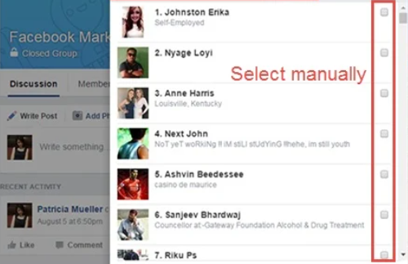
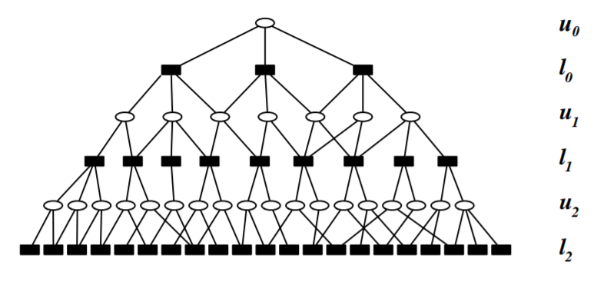
The internet has expanded the possibilities for snowball sampling, both manual and automated
Manual data collection
Automated data collection
Facebook Groups
Baltar and Brunet (2012)
Breuer and Groshek (2014)
Twitter Lists
Wu et al. (2010)
Ke et al. (2017)
5

Slide 6

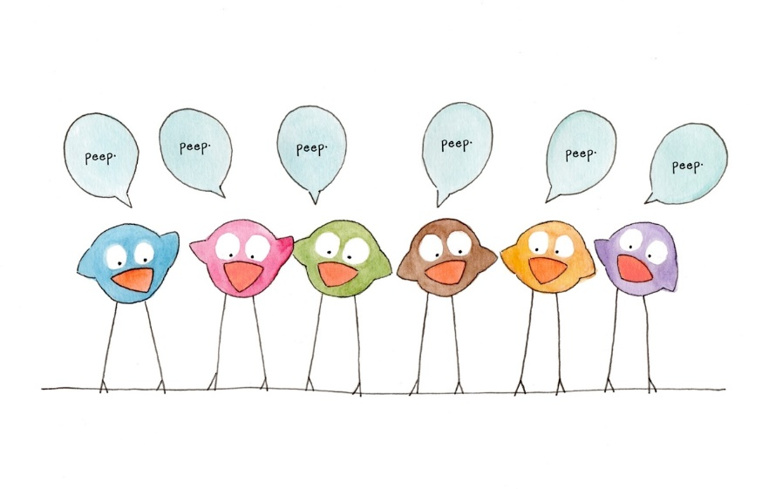

On Twitter, information spreads through retweets, which promote a user’s tweet to new audiences
A network perspective on retweets
When viewed as a node attribute, retweets are a measure of a user’s ability to influence information spread
(Cha et al. 2010, Kwak et al. 2010, Ackland 2013)
When viewed as an edge attribute, retweets can be used to identify users who are similar to one another
(Conover et al. 2011, Barbera 2015)
.. and that’s because they often serve as an endorsement of another user’s tweet
(Shmargad 2018, Shmargad and Sanchez 2020)
6

Slide 7

Starting from a set of tweets or users, we can follow retweets to generate their promotional landscape
Three projects using snowball sampling
Academic Articles:
Selecting Seeds
APIs vs. Web Scraping
Electoral Competition:
Network Metrics
Direct vs. Indirect Influence
Influencer Ecosystems:
Sampling Design
Polarization vs. Shared Attention
7

Slide 8

In our paper about promotion of academic articles, we study gender biases on Twitter (Klar et al. 2020)
We link article tweet data and citation counts
All 2016 articles published in:
American Political Science Review
Journal of Communication
American Politics Research
Political Research Quarterly
Journalism and Mass Communication Quarterly
Political Communication
Tweets + Retweets associated with larger citation counts
No evidence for gender bias in:
Tweets + Retweets
Relationship between Tweets + Retweets and citation counts
Retweeters
Tweet
Article
Tweet
Web scraping
Twitter API
8

Slide 9
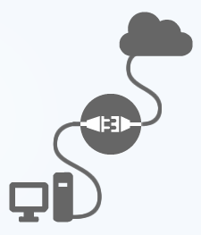
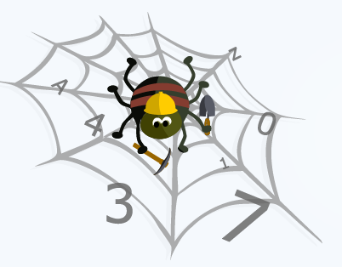
We searched for article links in Twitter’s Advanced Search and scraped the results
Twitter API
Generous for collecting
user timelines: Up to 3,200 most recent tweets (including replies and retweets)
retweets: Up to 100 most recent retweets per tweet
Less generous for collecting search results
Can only search for the past 7-10 days (unless you pay)
Biased towards central users (González-Bailón et al. 2012)
Web Scraping
Good because
Does not rely on API authentication or rate limits
In theory, can search for the entire history of a query
Bad because
IP address can get blocked, data can be inconsistent
Often forbidden under terms-of-service (Freelon 2018)
9

Slide 10
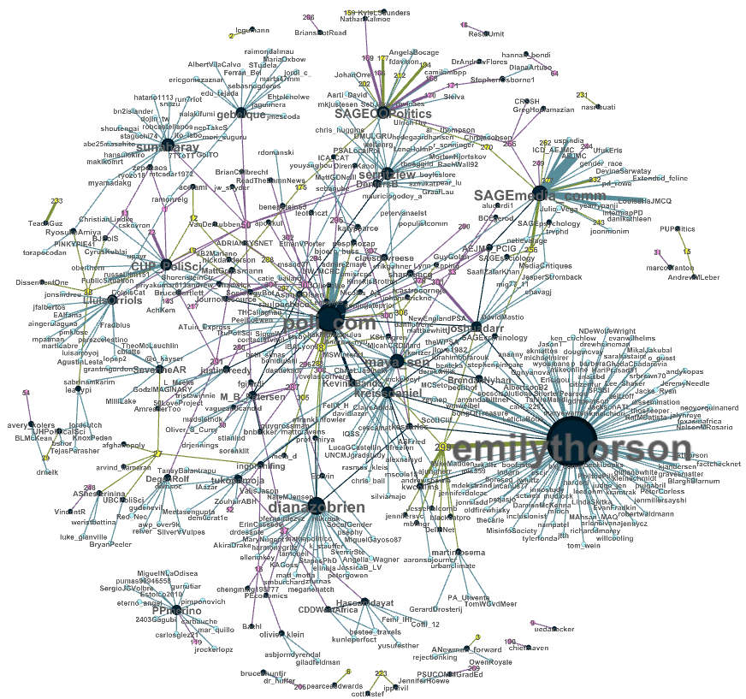
Image from Klar et al. (2020)

Slide 11
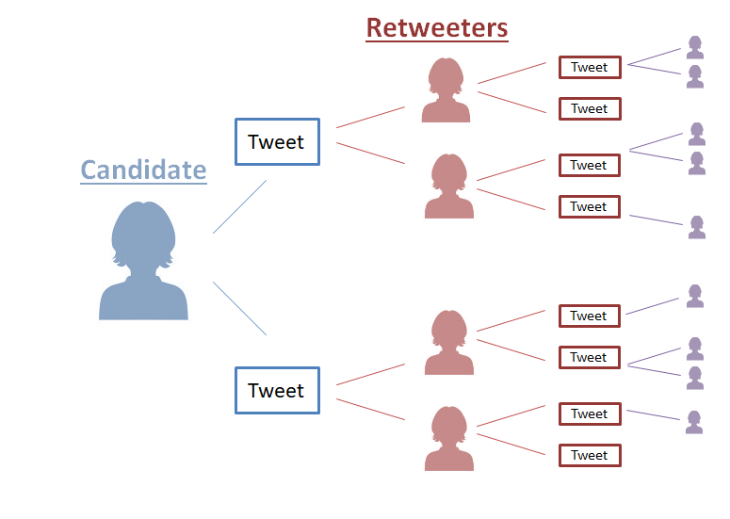
In a recent paper, I expand on this method to study political campaigns (Shmargad and Sanchez 2020)
Study of 2016 U.S. congressional candidates
Linked data from Twitter to campaign expenses (from the FEC)
Find that indirect influence (retweets by popular users) matters, not direct influence (total number of retweets)
Effect of indirect influence only holds for candidates at a financial disadvantage – no effects for the well-to-do
Effect is largest in races with large inequities or less spending
11

Slide 12
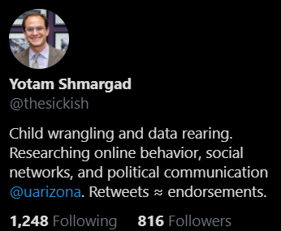
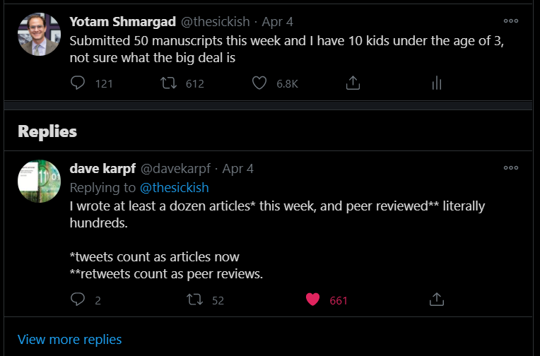
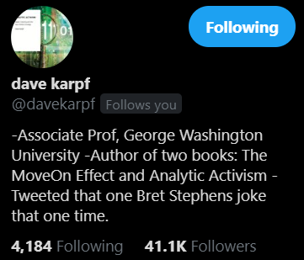
Anecdotal evidence for indirect influence from my only “viral” tweet
12

Slide 13
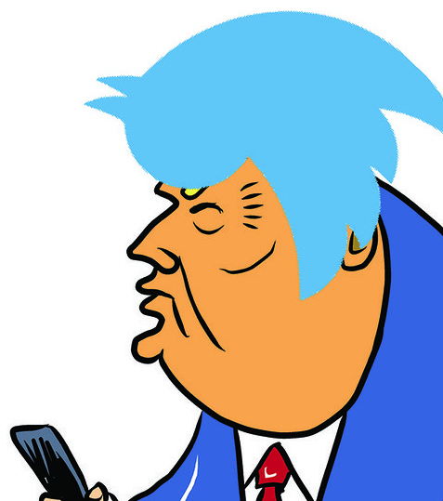

With snowball sampling, we can create a user’s retweet network (at least for mid-sized accounts)
Retweeters may retweet each other, so that we can compute network metrics
Edges have weights w_{ij} – the number of j’s tweets that i has retweeted
We classify the metrics into buckets (Hilbert et al. 2016)
One step: retweets / likes
Two step: retweets / likes / followers of retweeters
Network step: clustering coefficient, Burt’s constraint
2
w₂₁
1
w₂₃
w₃₂
w₃₁
3
13

Slide 14
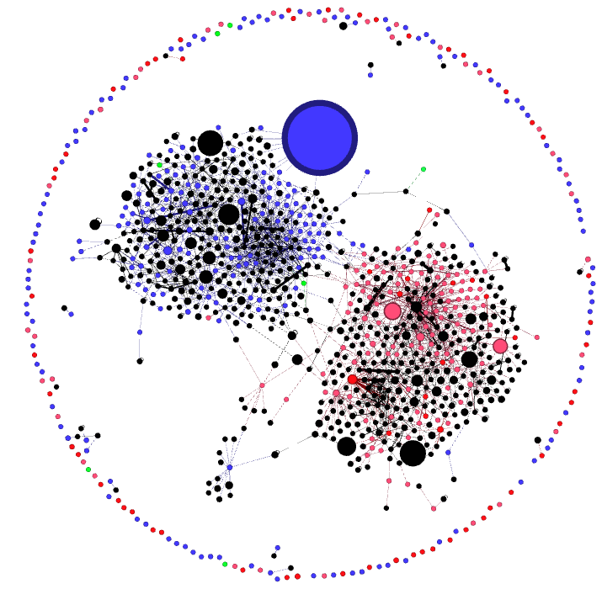


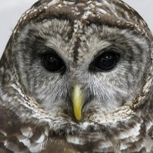
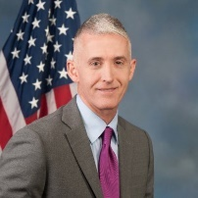

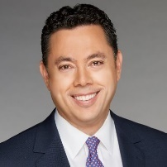
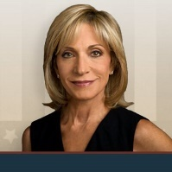



Image from Shmargad (2018)
@nick2crosby
@repjohnlewis
GA-5
@MaddowBlog
@TGowdySC
SC-4
@jasoninthehouse
UT-3
@MarkRuffalo
@mitchellreports
@ChatRevolve
@NubianAwakening
@Braveheart_USA

Slide 15
In a recent study, I augmented this sampling design to study retweeting among political influencers
Tweet
Tweet
Tweet
Tweet
Tweet
Tweet
Tweet
Tweet
Tweet
Tweet
15

Slide 16
In a recent study, I augmented this sampling design to study retweeting among political influencers
ECOSYSTEM: Received retweets from > 10 influencers
Retweet
Tweet
Tweet
Tweet
Tweet
Tweet
Retweet
Retweet
Tweet
Tweet
Tweet
Tweet
INFLUENCER: Received > 10 retweets on their tweets, on average
Tweet
Retweet
16

Slide 17
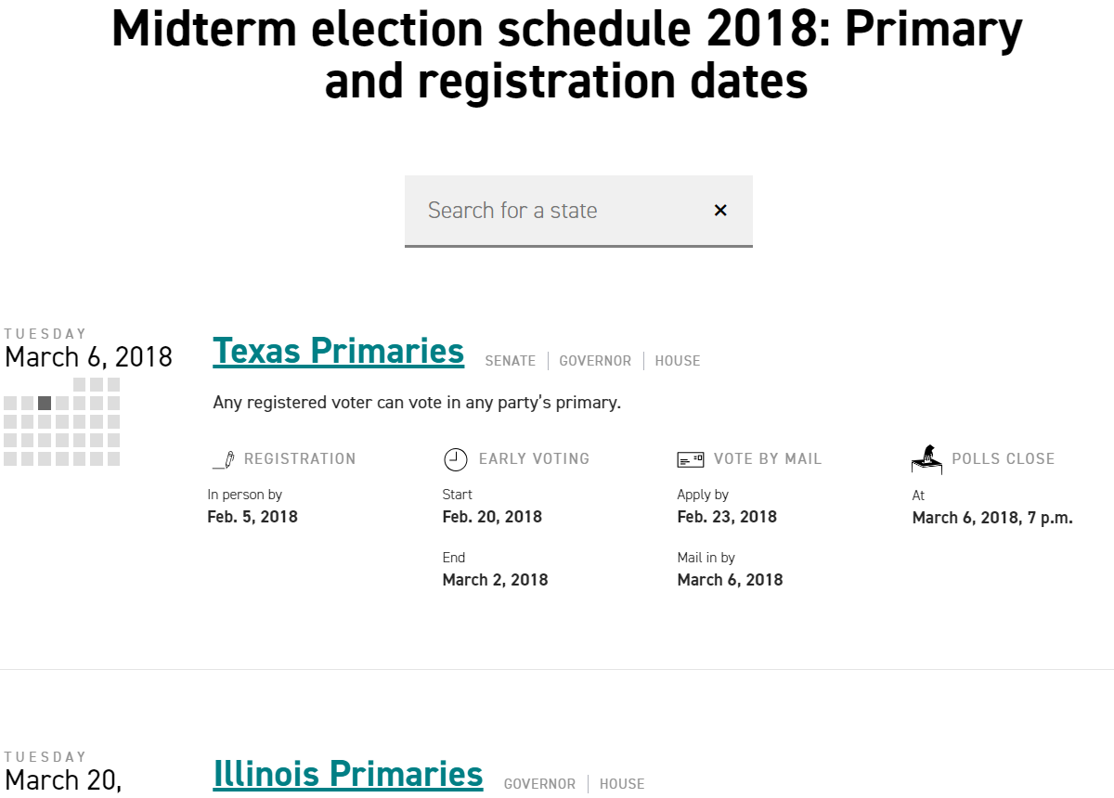
To collect candidate information, I scraped Politico for election results of the 2018 U.S. primary races
Google Search
17

Slide 18
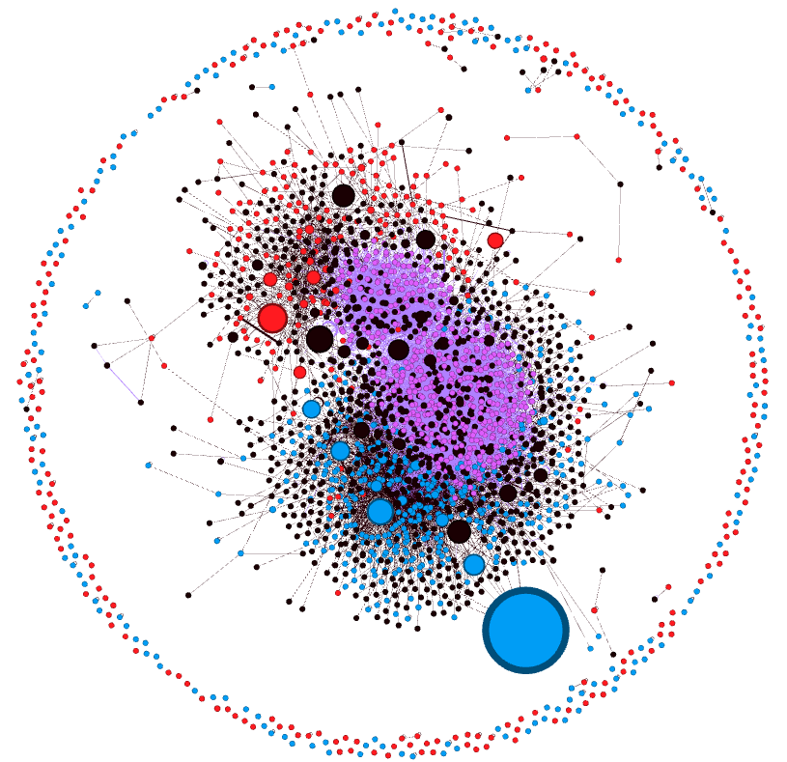
Though polarization exists, the ecosystem bridges political party clusters via shared attention
Interactive Visualization
www.yotamshmargad.com/COMMON_GROUND
Other findings
Political influencers on both sides are most often activists (no formal role identified)
Republican-leaning influencers skew towards activists, while Democrat-leaning influencers skew more towards having formal roles (Grossman and Hopkins 2016)
18

Slide 19
Snowball sampling can help us study the diffusion of tweets and the equalizing potential of Twitter
Concluding thoughts and future work
Whereas Katz and Lasarsfeld (1955) start with voters to identify influentials, I start with candidates (“two-step flow on its head”)
This method is thus more suitable for the study of promotion than public opinion. Representativeness of Twitter is an issue.
While retweets measure the extent that messages are pushed, another promotional strategy is pulling in people via mentions.
While retweets often serve as endorsements, quote tweets (or “retweets with comments”) may not. Currently, one needs Twitter’s premium API or web scraping to collect these at scale.
Snowball sampling can take us beyond studying communities built around search terms to the broader ecosystems of users
19

Slide 20
Winter Institute in Computational Social Science
Day 4: Social Networks
Thursday January 7th, 2020

